Slide 1
WELCOME
Performance Centre Kick-Off meeting 22nd July 2023

Slide 2
Aim of Open Day…
Get everyone together
Introduce coaches and everyone involved
Share our goals and vision going forward
Your chance to ask questions and share feedback
Get on court and have some matches!

Slide 3
Structure
Coaches
Steven Jacobs - Head Coach
Daryl Jacobs
Jess Pugh
Harley Towler
Admin
Lauren Jacobs- Performance Centre Admin
Alistair Jones – Centre Manager, Child Protection/Welfare Officer
Derek Moule - Centre Assistant Manager.

Slide 4
Running of Wycombe Performance Centre
Wycombe Badminton Centre have now taken on the role of running the PC in its entirety.
We will be helping PC to move forward in a positive direction to grow. Both, in terms of providing more opportunities for young talent, as well as providing quality training for our best and most talented players.

Slide 5
Performance Centre and our Goals
So, what is Wycombe PC and what is it all about?
We aim to scout talented players and give them a high-performance environment to train in and hone their skills.
Our goal is to produce high standard players that can compete nationally and then go on to represent England.
We want to provide players with all the skills and knowledge needed to help them reach their full potential.
We will provide player reviews

Slide 6
How we do this…
Quality Venue
Skilled Coaches
Talented players

Slide 7
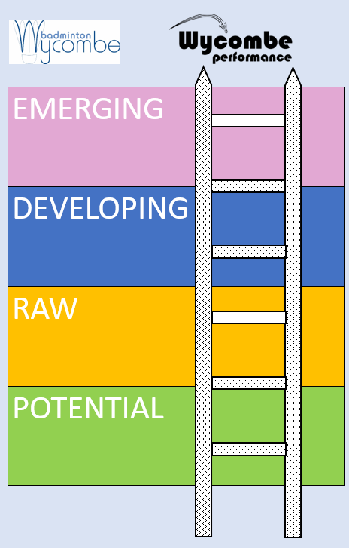
PC Sessions
4 Groups:–
Emerging, Developing, Raw & Potential
Sessions:
- Monday Emerging & Potential
- Tuesday Developing
- Wednesday Emerging
- Thursday Developing & Raw/Potential
- Friday Developing/Raw
Monday POTENTIAL | Monday EMERGING | Tuesday DEVELOPING | Wednesday EMERGING | Thursday DEVELOPING | Thursday POTENTIAL/RAW | Friday RAW
5 - 6.30pm | 5.45 - 8pm | 5.45 - 8pm | 5.45 - 8pm | 5.45 - 8pm | 5.45 - 8pm | 6.30 - 8.45pm
2 courts | 2 courts | 3 courts | 2 courts | 1 courts | 3 courts | 3 courts

Slide 8
Since starting in January 2009...
Established a performance ethos
Provided a full-time environment to compliment PC sessions.
Produced players capable of European competition at junior and senior levels
Performance planning
Player reviews
Work-shops (fitness testing, performance quiz, stability and strength, video analysis, parent support, tournament and match craft)
Performance pathway improvements

Slide 9
Future...
Spreading the performance ethos
More graded players
Increased high quality coaches
More nominations for National Training Days and National Talent Identification
More club players and more club players becoming leaders and coaches
More competition players competing regularly
More funding and sponsorship

Slide 10
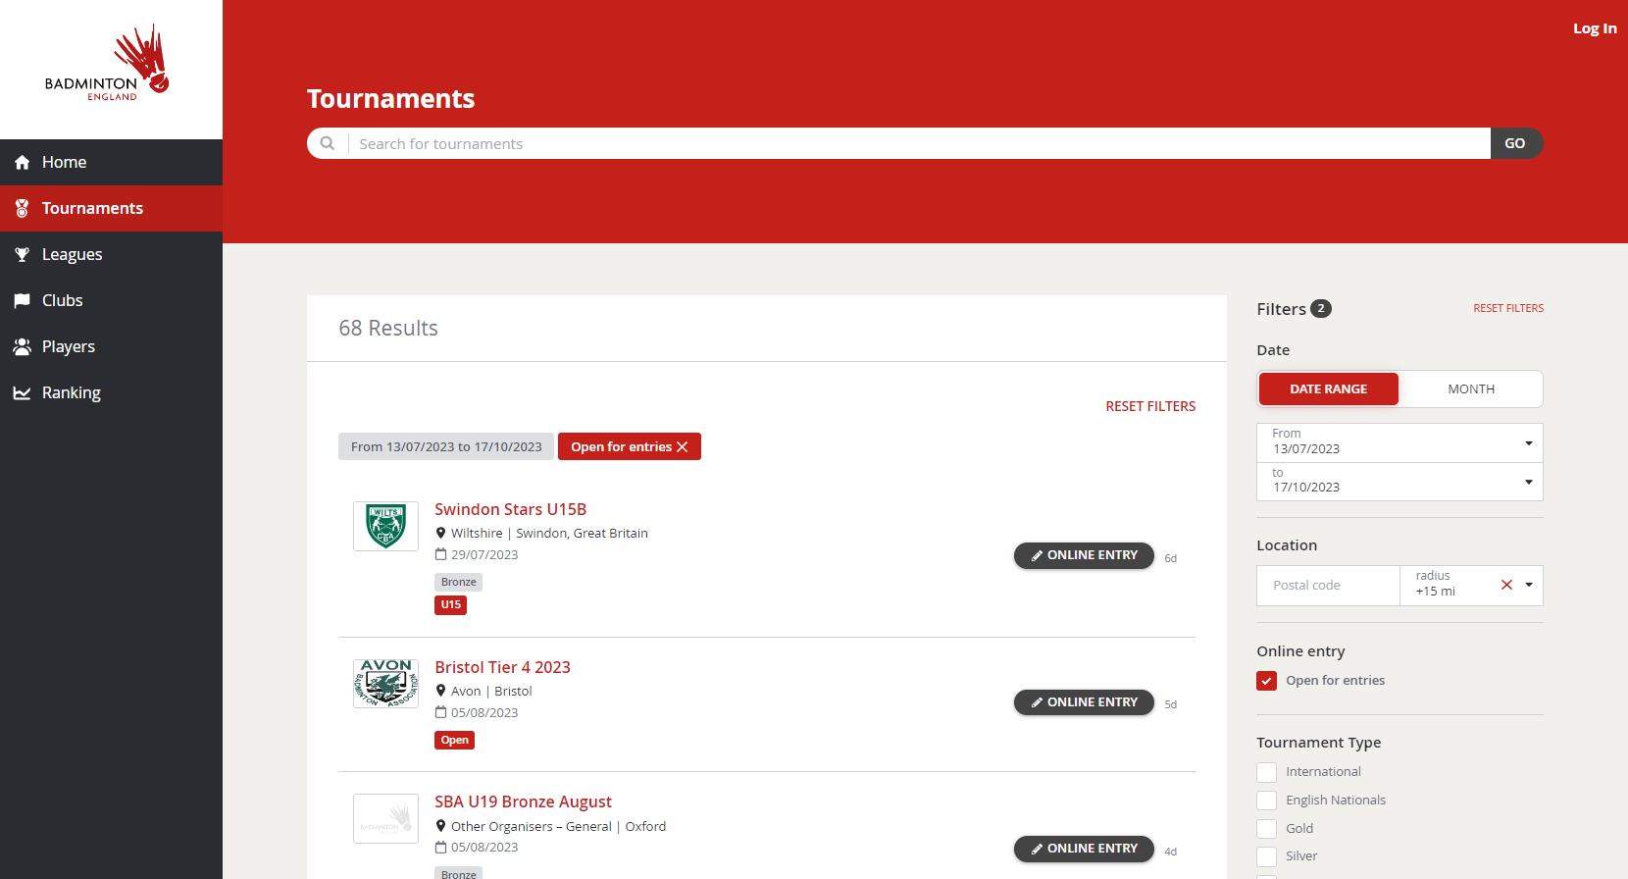
Badminton England Tournaments
These tournaments can be entered via the Badminton England website or tournament software. You will need to sign up and become a BE member to enter.

Slide 11
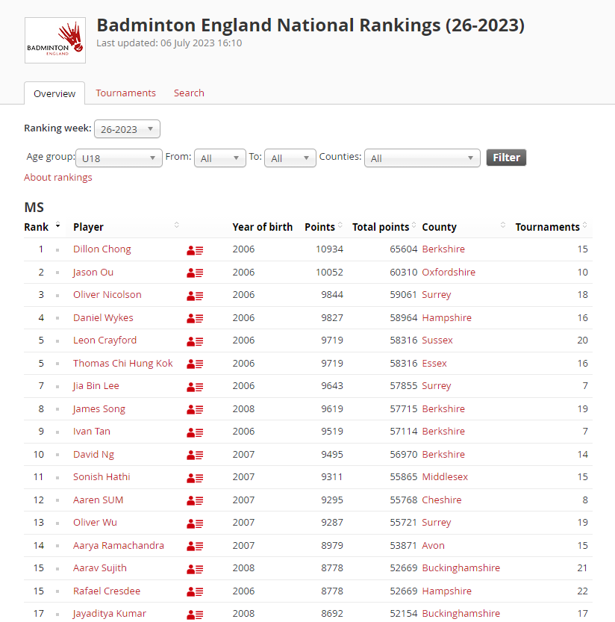
How they Work?
Players will start of playing in bronze in their respective age groups and as you progress will play silver, gold and then gold star.
For juniors, tournaments start at U11 and go up every 2 years until U19.
Once you played a few you’ll get a grading and national ranking you can then build on and improve.

Slide 12
Tournaments
Many of our top players currently play in Badminton England tournaments. This not only is a pathway for getting spotted and selected to be part of England training squad and matches but is a great way to gain tournament experience that is valuable for every players progression.
We encourage all our players to enter these. They are scattered across the country and anyone can enter.

Slide 13
Any questions?
Thank you for your time…

